Slide 1
Calculation of the bed shear stress

Slide 2
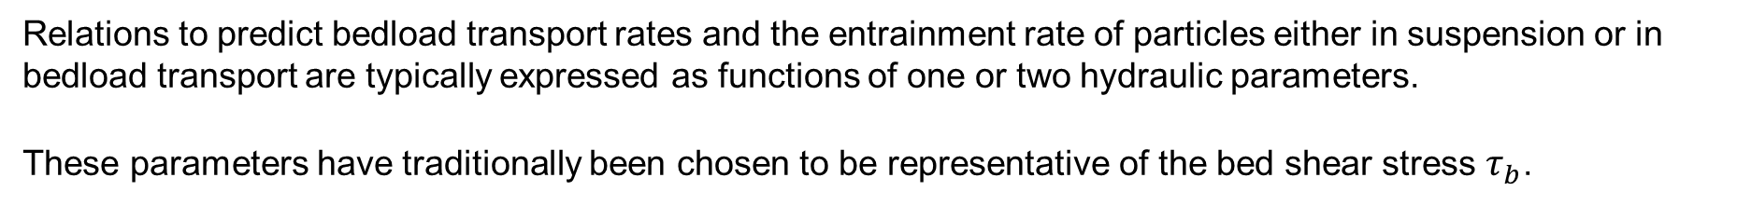
Why is this important?
Relations to predict bedload transport rates and the entrainment rate of particles either in suspension or in bedload transport are typically expressed as functions of one or two hydraulic parameters.
These parameters have traditionally been chosen to be representative of the bed shear stress $τ_{b}$.

Slide 3
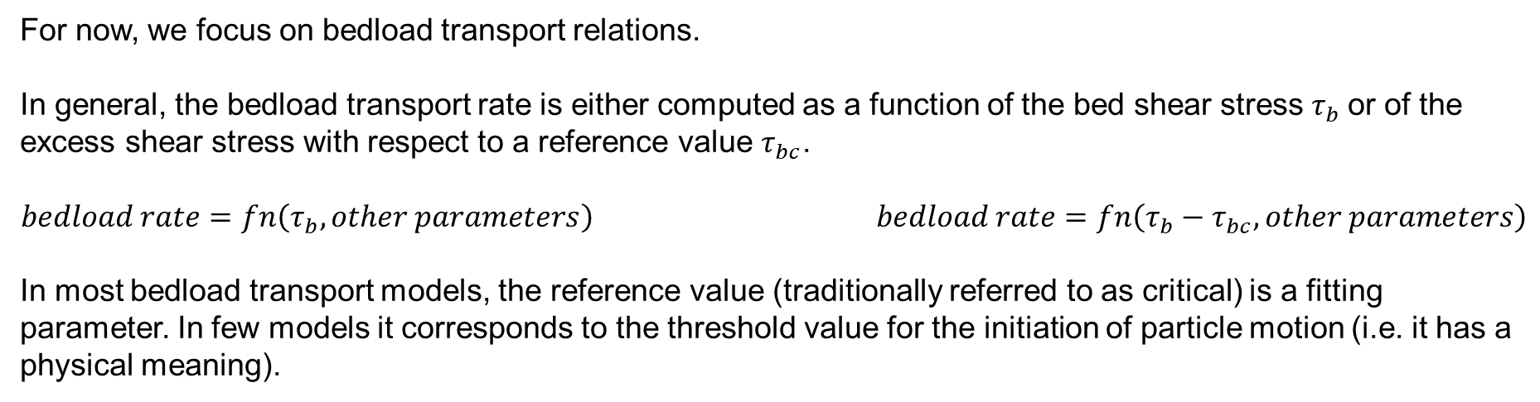
Why is this important?
Relations to predict bedload transport rates and the entrainment rate of particles either in suspension or in bedload transport are typically expressed as functions of one or two hydraulic parameters.
These parameters have traditionally been chosen to be representative of the bed shear stress $τ_{b}$.
For now, we focus on bedload transport relations.
In general, the bedload transport rate is either computed as a function of the bed shear stress $τ_{b}$or of the excess shear stress with respect to a reference value $τ_{bc}$.
$$bedload rate=fn\left(τ_{b}, other parameters\right) bedload rate=fn\left(τ_{b}−τ_{bc}, other parameters\right)$$
In most bedload transport models, the reference value (traditionally referred to as critical) is a fitting parameter. In few models it corresponds to the threshold value for the initiation of particle motion (i.e. it has a physical meaning).

Slide 4
Why is this important?
If we want to estimate the bedload transport rate, we need to estimate the bed shear stress $τ_{b}$

Slide 5
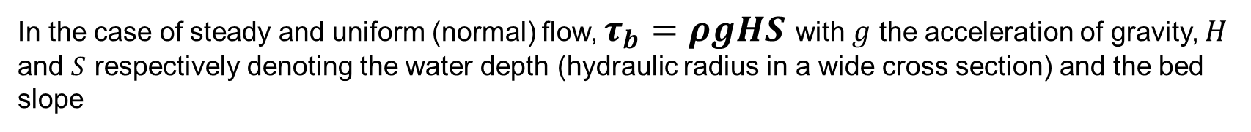
Why is this important?
If we want to estimate the bedload transport rate, we need to estimate the bed shear stress $τ_{b}$
Reminder (L_02.pptx)
In general, $τ_{b}=ρC_{f}U^{2}$ with $C_{f}$being a non-dimensional friction coefficient and $U$ denoting the mean flow velocity
In the case of steady and uniform (normal) flow, $τ_{b}=ρgHS$ with $g$ the acceleration of gravity, $H$ and $S$ respectively denoting the water depth (hydraulic radius in a wide cross section) and the bed slope

Slide 6
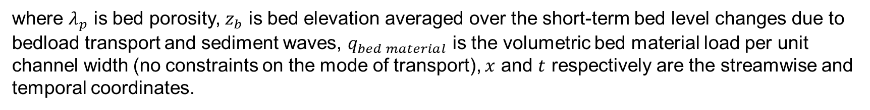

When can we assume normal flow?
The equation expressing the conservation of bed material (the Exner equation) takes the form (see prof. Izumi’s handouts)
$$\left(1−λ_{p}\right)\frac{∂z_{b}}{∂t}=−\frac{∂q_{bed material}}{∂x}$$
where $λ_{p}$ is bed porosity, $z_{b}$ is bed elevation averaged over the short-term bed level changes due to bedload transport and sediment waves, $q_{bed material}$ is the volumetric bed material load per unit channel width (no constraints on the mode of transport), $x$ and $t$ respectively are the streamwise and temporal coordinates.

Slide 7
When can we assume normal flow?
The equation expressing the conservation of bed material (the Exner equation) takes the form (see prof. Izumi’s handouts)
$$\left(1−λ_{p}\right)\frac{∂z_{b}}{∂t}=−\frac{∂q_{bed material}}{∂x}$$
where $λ_{p}$ is bed porosity, $z_{b}$ is bed elevation averaged over the short-term bed level changes due to bedload transport and sediment waves, $q_{bed material}$ is the volumetric bed material load per unit channel width (no constraints on the mode of transport), $x$ and $t$ respectively are the streamwise and temporal coordinates.
If I am conducting experiments to find a relation linking the bedload transport rate to the bed shear stress, I need time to measure the flow characteristics, the bed elevation and (depending on the type of flume) the bedload transport rate.
In other words, I do my measurements when the transport regime (plane bed, with bedforms …) and the average flow conditions are not changing in time, that is when there is, on average, no bed level (slope) change.
We call this condition mobile bed equilibrium (sediment is transported but the average channel bed and the flow are not changing).

Slide 8

When can we assume normal flow?
Mathematically, the condition of mobile bed equilibrium is expressed as
$$\left(1−λ_{p}\right)\frac{∂z_{b}}{∂t}=−\frac{∂q_{bed material}}{∂x}=0$$

Slide 9
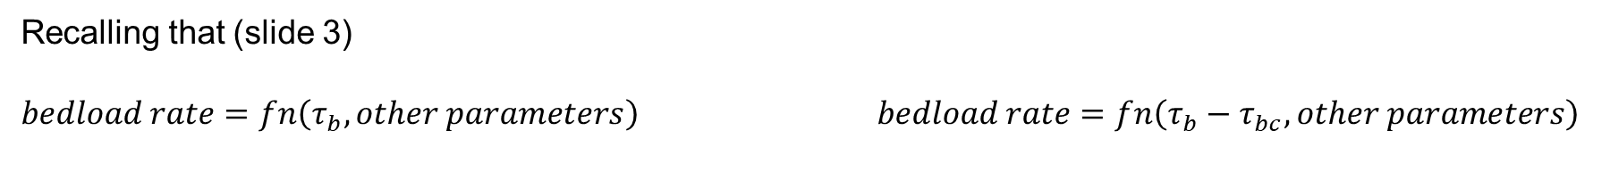
When can we assume normal flow?
Mathematically, the condition of mobile bed equilibrium is expressed as
$$\left(1−λ_{p}\right)\frac{∂z_{b}}{∂t}=−\frac{∂q_{bed material}}{∂x}=0$$
Recalling that (slide 3)
$bedload rate=fn\left(τ_{b}, other parameters\right) bedload rate=fn\left(τ_{b}−τ_{bc}, other parameters\right)$
The condition $\frac{∂q_{bed material}}{∂x}=0$, corresponds to $\frac{∂τ_{b}}{∂x}=0$
or $τ_{b}=constant (uniform)$

Slide 10
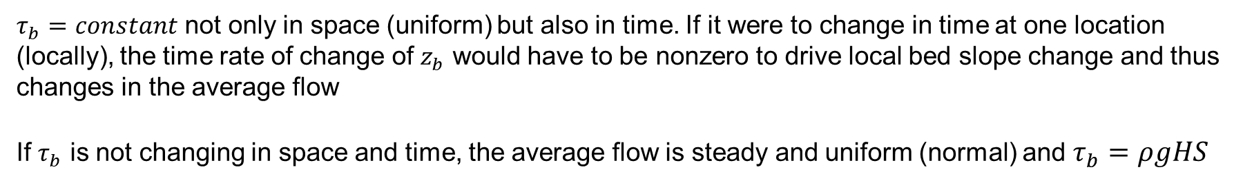
When can we assume normal flow?
Mathematically, the condition of mobile bed equilibrium is expressed as
$$\left(1−λ_{p}\right)\frac{∂z_{b}}{∂t}=−\frac{∂q_{bed material}}{∂x}=0$$
Recalling that (slide 3)
$bedload rate=fn\left(τ_{b}, other parameters\right) bedload rate=fn\left(τ_{b}−τ_{bc}, other parameters\right)$
The condition $\frac{∂q_{bed material}}{∂x}=0$, corresponds to $\frac{∂τ_{b}}{∂x}=0$
or $τ_{b}=constant (uniform)$
$τ_{b}=constant$ not only in space (uniform) but also in time. If it were to change in time at one location (locally), the time rate of change of $z_{b}$ would have to be nonzero to drive local bed slope change and thus changes in the average flow
If $τ_{b}$ is not changing in space and time, the average flow is steady and uniform (normal) and $τ_{b}=ρgHS$

Slide 11
When can we assume normal flow?
Mathematically, the condition of mobile bed equilibrium is expressed as
$$\left(1−λ_{p}\right)\frac{∂z_{b}}{∂t}=−\frac{∂q_{bed material}}{∂x}=0$$
Terminology reminder
Average flow here means that the flow parameters are averaged over time scales that are long compared to those typical of bed level change for bedload transport (particle entrainment or deposition – bedload video) and bedform migration (all the videos of L_03.pptx)
Recalling that (slide 3)
$bedload rate=fn\left(τ_{b}, other parameters\right) bedload rate=fn\left(τ_{b}−τ_{bc}, other parameters\right)$
The condition $\frac{∂q_{bed material}}{∂x}=0$, corresponds to $\frac{∂τ_{b}}{∂x}=0$
or $τ_{b}=constant (uniform)$
$τ_{b}=constant$ not only in space (uniform) but also in time. If it were to change in time at one location (locally), the time rate of change of $z_{b}$ would have to be nonzero to drive local bed slope change and thus changes in the average flow
If $τ_{b}$ is not changing in space and time, the average flow is steady and uniform (normal) and $τ_{b}=ρgHS$

Slide 12
Class project - Part 1
I prepared an excel file called FamousDatasets.xlsx and I uploaded it in the excel_files folder of the HSI repository. You should also find it in Moodle.
In this file you will find data of famous bedload transport experiments, i.e. those performed by Meyer-Peter and Muller and those performed by Gilbert.
Part 1 of the class project consists in estimating the component of the bed shear stress in these experiments that contributed to bedload transport.

Slide 13
Class project - Part 1
I prepared an excel file called FamousDatasets,xlsx and I uploaded it in the excel_files folder of the HSI repository. You should also find it in Moodle.
In this file you will find data of famous bedload transport experiments, i.e. those performed by Meyer-Peter and Muller and those performed by Gilbert.
Part 1 of the class project consists in estimating the component of the bed shear stress in these experiments that contributed to bedload transport.
This will be done in two steps:
STEP 1: bed shear stress in laboratory flumes are affected by the presence of smooth sidewalls. The sidewall correction procedure (next slides) i s supposed to eliminate the wall effect a s far as the calculation of the bed friction i s concerned, but there is no known correction for the effect of the walls on the sediment transportation and dune configuration (Vanoni and Brooks, 1957).
STEP 2: partition of the sidewall corrected bed shear stress between skin friction (contributing to bedload transport) and form drag (not contributing to bedload transport)

Slide 14
Procedure to remove sidewall effects from measured data
Known parameters
Unknowns
Flume width B
Water discharge Q
Water depth H
Bed slope S
Sediment properties R, D_{g}, D₅₀, D₉₀
Water properties ρ, ν
Acceleration of gravity g
Shear stress acting on the bed τ_{b}
Shear stress acting on the wall τ_{w}
Smooth wall
Rough bed

Slide 15
Procedure to remove sidewall effects from measured data
Known parameters
Unknowns
Flume width B
Water discharge Q
Water depth H
Bed slope S
Sediment properties R, D_{g}, D₅₀, D₉₀
Water properties ρ, ν
Acceleration of gravity g
Shear stress acting on the bed τ_{b}
Shear stress acting on the wall τ_{w}
Smooth wall
Rough bed
Main assumptions
The cross section is divided in two non-interacting regions, the bed region and the wall region. In these regions, the streamwise component of the gravity force if balanced by the resistive force (normal flow).
Mean flow velocity U and energy gradient S are the same in the wall and in the bed region, and in the cross section.
The Darcy-Weisbach resistance relation can be applied to each region and to the cross section

Slide 16



Procedure to remove sidewall effects from measured data
Formulation of the problem
The wetted perimeter of the cross section P is equal to the sum of the wetted perimeters of the bed P_{b} and of the wall P_{w} regions
Smooth wall
$$P=P_{b}+P_{w}=B+2H$$
$$P_{b}=B$$
$$P_{w}=2H$$
Rough bed

Slide 17



Procedure to remove sidewall effects from measured data
Formulation of the problem
The wetted perimeter of the cross section P is equal to the sum of the wetted perimeters of the bed P_{b} and of the wall P_{w} regions
Smooth wall
$$P=P_{b}+P_{w}=B+2H$$
$$P_{b}=B$$
$$P_{w}=2H$$
Rough bed
Equation of conservation of mass
the discharge is equal to the sum of the discharge in the bed and in the wall region
The flow velocity is the same in all regions
$$Q=Q_{b}+Q_{w}$$
$$UA=UA_{b}+UA_{w}$$
$$A=A_{b}+A_{w}$$

Slide 18



Procedure to remove sidewall effects from measured data
Formulation of the problem
The wetted perimeter of the cross section P is equal to the sum of the wetted perimeters of the bed P_{b} and of the wall P_{w} regions
Smooth wall
$$P=P_{b}+P_{w}=B+2H$$
$$P_{b}=B$$
$$P_{w}=2H$$
Rough bed
Equation of conservation of mass
the discharge is equal to the sum of the discharge in the bed and in the wall region
The flow velocity is the same in all regions
$$Q=Q_{b}+Q_{w}$$
$$UA=UA_{b}+UA_{w}$$
$$A=A_{b}+A_{w}$$
Equation of conservation of streamwise momentum
the downstream pull of gravity is balanced by the resistive force on the boundary
In the cross section
$$ρgAS∆x=τP∆x$$
$τ$ is the average boundary shear stress in the cross section
In the bed region
$$ρgA_{b}S∆x=τ_{b}P_{b}∆x$$
In the wall region
$$ρgA_{w}S∆x=τ_{w}P_{w}∆x$$

Slide 19
Procedure to remove sidewall effects from measured data
Formulation of the problem
The wetted perimeter of the cross section P is equal to the sum of the wetted perimeters of the bed P_{b} and of the wall P_{w} regions
Smooth wall
$$P=P_{b}+P_{w}=B+2H$$
$$P_{b}=B$$
$$P_{w}=2H$$
Rough bed
Equation of conservation of mass
the discharge is equal to the sum of the discharge in the bed and in the wall region
The flow velocity is the same in all regions
$$Q=Q_{b}+Q_{w}$$
$$UA=UA_{b}+UA_{w}$$
$$A=A_{b}+A_{w}$$
Equation of conservation of streamwise momentum
the downstream pull of gravity is balanced by the resistive force on the boundary
Subtracting the equations of conservation in the bed and wall regions from the equation of conservation in the cross section it is found that
$ρgAS∆x−ρgA_{b}S∆x−ρgA_{w}S∆x=τP∆x−τ_{b}P_{b}∆x−$ $τ_{w}P_{w}∆x$
$ρgS\left(A−A_{b}+A_{w}\right)=τP−τ_{b}P_{b}−$ $τ_{w}P_{w}$
$τP−τ_{b}P_{b}−$ $τ_{w}P_{w}$
= 0

Slide 20


Procedure to remove sidewall effects from measured data
Formulation of the problem
The wetted perimeter of the cross section P is equal to the sum of the wetted perimeters of the bed P_{b} and of the wall P_{w} regions
Smooth wall
$$P=P_{b}+P_{w}=B+2H$$
$$P_{b}=B$$
$$P_{w}=2H$$
Rough bed
Equation of conservation of mass
the discharge is equal to the sum of the discharge in the bed and in the wall region
The flow velocity is the same in all regions
$$Q=Q_{b}+Q_{w}$$
$$UA=UA_{b}+UA_{w}$$
$$A=A_{b}+A_{w}$$
Equation of conservation of streamwise momentum
the downstream pull of gravity is balanced by the resistive force on the boundary
$τP=τ_{b}P_{b}+$ $τ_{w}P_{w}$
Recalling that $τ=ρC_{f}U^{2}$ and that $U$ is the same in all regions
$C_{f}P=C_{fb}P_{b}+$ $C_{fw}P_{w}$

Slide 21

Procedure to remove sidewall effects from measured data
Formulation of the problem
The wetted perimeter of the cross section P is equal to the sum of the wetted perimeters of the bed P_{b} and of the wall P_{w} regions
Smooth wall
$$P=P_{b}+P_{w}=B+2H$$
$$P_{b}=B$$
$$P_{w}=2H$$
Rough bed
Equation of conservation of mass
the discharge is equal to the sum of the discharge in the bed and in the wall region
The flow velocity is the same in all regions
$$Q=Q_{b}+Q_{w}$$
$$UA=UA_{b}+UA_{w}$$
$$A=A_{b}+A_{w}$$
Equation of conservation of streamwise momentum
the downstream pull of gravity is balanced by the resistive force on the boundary
$C_{f}P=C_{fb}P_{b}+$ $C_{fw}P_{w}$
The Darcy-Weisbach resistance relation holds in all regions

Slide 22
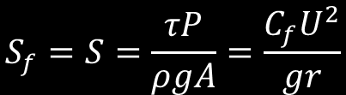

Procedure to remove sidewall effects from measured data
Formulation of the problem
The wetted perimeter of the cross section P is equal to the sum of the wetted perimeters of the bed P_{b} and of the wall P_{w} regions
Smooth wall
$$P=P_{b}+P_{w}=B+2H$$
$$P_{b}=B$$
$$P_{w}=2H$$
Darcy-Weisbach for pipe and open channel flow
Rough bed
Equation of conservation of mass
the discharge is equal to the sum of the discharge in the bed and in the wall region
B
The flow velocity is the same in all regions
$$Q=Q_{b}+Q_{w}$$
$$UA=UA_{b}+UA_{w}$$
$$S_{f}=S=\frac{τP}{ρgA}=\frac{C_{f}U^{2}}{gr}$$
$$S_{f}=f\frac{U^{2}}{2gd}$$
d
$$A=A_{b}+A_{w}$$
H
Equation of conservation of streamwise momentum
the downstream pull of gravity is balanced by the resistive force on the boundary
r is hydraulic radius, equal to cross sectional aera over wetted perimeter
$C_{f}P=C_{fb}P_{b}+$ $C_{fw}P_{w}$
The Darcy-Weisbach resistance relation holds in all regions

Slide 23
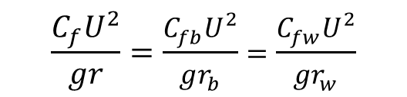
Procedure to remove sidewall effects from measured data
Formulation of the problem
The wetted perimeter of the cross section P is equal to the sum of the wetted perimeters of the bed P_{b} and of the wall P_{w} regions
Smooth wall
$$P=P_{b}+P_{w}=B+2H$$
$$P_{b}=B$$
$$P_{w}=2H$$
Rough bed
Equation of conservation of mass
the discharge is equal to the sum of the discharge in the bed and in the wall region
B
The flow velocity is the same in all regions
$$Q=Q_{b}+Q_{w}$$
$$UA=UA_{b}+UA_{w}$$
$$A=A_{b}+A_{w}$$
Equation of conservation of streamwise momentum
the downstream pull of gravity is balanced by the resistive force on the boundary
$C_{f}P=C_{fb}P_{b}+$ $C_{fw}P_{w}$
The Darcy-Weisbach resistance relation holds in all regions
$$\frac{C_{f}U^{2}}{gr}=\frac{C_{fb}U^{2}}{gr_{b}}=\frac{C_{fw}U^{2}}{gr_{w}}$$

Slide 24
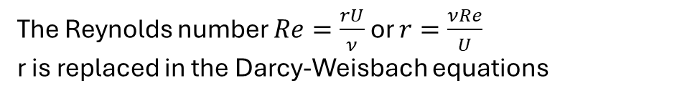
Procedure to remove sidewall effects from measured data
Formulation of the problem
The wetted perimeter of the cross section P is equal to the sum of the wetted perimeters of the bed P_{b} and of the wall P_{w} regions
Smooth wall
$$P=P_{b}+P_{w}=B+2H$$
$$P_{b}=B$$
$$P_{w}=2H$$
Rough bed
Equation of conservation of mass
the discharge is equal to the sum of the discharge in the bed and in the wall region
B
The flow velocity is the same in all regions
$$Q=Q_{b}+Q_{w}$$
$$UA=UA_{b}+UA_{w}$$
$$A=A_{b}+A_{w}$$
Equation of conservation of streamwise momentum
the downstream pull of gravity is balanced by the resistive force on the boundary
$C_{f}P=C_{fb}P_{b}+$ $C_{fw}P_{w}$
The Darcy-Weisbach resistance relation holds in all regions
$$\frac{C_{f}U^{2}}{gr}=\frac{C_{fb}U^{2}}{gr_{b}}=\frac{C_{fw}U^{2}}{gr_{w}}$$
The Reynolds number $Re=\frac{rU}{ν}$ or $r=\frac{νRe}{U}$
r is replaced in the Darcy-Weisbach equations

Slide 25
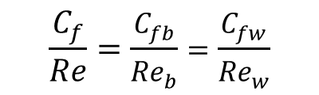
Procedure to remove sidewall effects from measured data
Formulation of the problem
The wetted perimeter of the cross section P is equal to the sum of the wetted perimeters of the bed P_{b} and of the wall P_{w} regions
Smooth wall
$$P=P_{b}+P_{w}=B+2H$$
$$P_{b}=B$$
$$P_{w}=2H$$
Rough bed
Equation of conservation of mass
the discharge is equal to the sum of the discharge in the bed and in the wall region
B
The flow velocity is the same in all regions
$$Q=Q_{b}+Q_{w}$$
$$UA=UA_{b}+UA_{w}$$
$$A=A_{b}+A_{w}$$
Equation of conservation of streamwise momentum
the downstream pull of gravity is balanced by the resistive force on the boundary
$C_{f}P=C_{fb}P_{b}+$ $C_{fw}P_{w}$
The Darcy-Weisbach resistance relation holds in all regions
$$\frac{C_{f}}{Re}=\frac{C_{fb}}{{Re}_{b}}=\frac{C_{fw}}{{Re}_{w}}$$

Slide 26

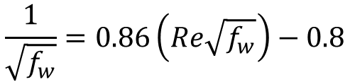

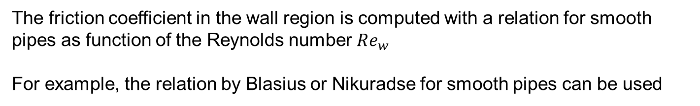





Friction coefficient in the wall region
The friction coefficient in the wall region is computed with a relation for smooth pipes as function of the Reynolds number $Re_{w}$
For example, the relation by Blasius or Nikuradse for smooth pipes can be used
Smooth wall
$$f_{w}=\frac{0.316}{{Re}^{1/4}}$$
$$\frac{1}{\sqrt{f_{w}}}=0.86\left(Re\sqrt{f_{w}}\right)−0.8$$
Rough bed
Darcy-Weisbach for pipe and open channel flow
Subscripts p and oc indicate pipe and open channel, respectively
How to go from pipe flow to open channel flow?
B
$$S_{f}=f\frac{U^{2}}{2gd}$$
$$S_{f}=S=\frac{C_{f}U^{2}}{gr}$$
d
H
$$r=\frac{A}{P}=\frac{π\frac{d^{2}}{4}}{πd}=\frac{d}{4}$$
$$S_{f}=f\frac{U^{2}}{2g4r}$$
$$\frac{f}{8}=C_{f}$$
$$Re_{p}=\frac{Ud}{ν}=4\frac{Ur}{ν}=4{Re}_{oc}$$
and

Slide 27
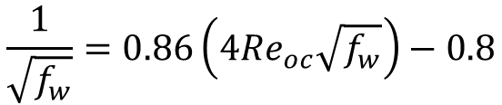
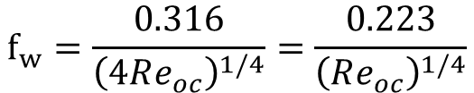
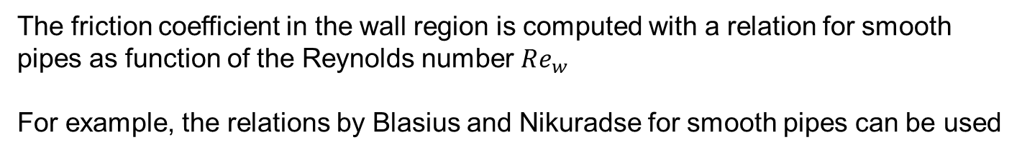



Friction coefficient in the wall region
The friction coefficient in the wall region is computed with a relation for smooth pipes as function of the Reynolds number $Re_{w}$
For example, the relations by Blasius and Nikuradse for smooth pipes can be used
Smooth wall
$$f_{w}=\frac{0.316}{{Re}^{1/4}}$$
$$\frac{1}{\sqrt{f_{w}}}=0.86\left(Re\sqrt{f_{w}}\right)−0.8$$
Rough bed
How to go from pipe flow to open channel flow?
Noting that
$$Re_{p}=4{Re}_{oc}$$
the relations by Blasius and Nikuradse for smooth boundary in open channel flow take the form
$$f_{w}=\frac{0.316}{{\left(4Re_{oc}\right)}^{1/4}}=\frac{0.223}{{\left(Re_{oc}\right)}^{1/4}}$$
$$\frac{1}{\sqrt{f_{w}}}=0.86\left(4Re_{oc}\sqrt{f_{w}}\right)−0.8$$
$$\frac{f}{8}=C_{f}$$
In the calculation of the friction factor for the wall region $Re_{oc} = Re_{w}$

Slide 28

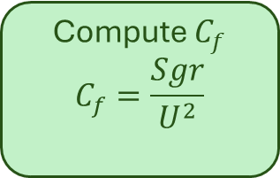
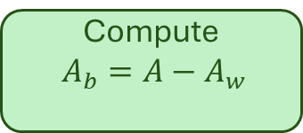
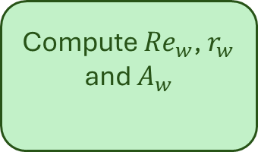
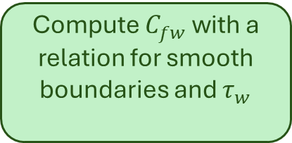
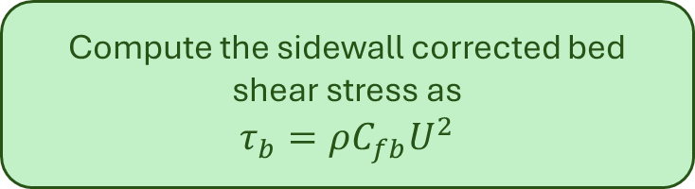
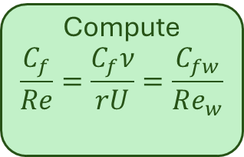

Sidewall correction calculation procedure
Known parameters
Unknowns
Flume width B
Water discharge Q
Water depth H
Bed slope S
Sediment properties R, D_{g}, D₅₀, D₉₀
Water properties ρ, ν
Acceleration of gravity g
Shear stress acting on the bed τ_{b}
Shear stress acting on the wall τ_{w}
Smooth wall
Rough bed
Compute $C_{f}$
$$C_{f}=\frac{Sgr}{U^{2}}$$
Compute
$$\frac{C_{f}}{Re}=\frac{C_{f}ν}{rU}=\frac{C_{fw}}{Re_{w}}$$
Compute $C_{fw}$ with a relation for smooth boundaries and $τ_{w}$
Compute ${Re}_{w}$, $r_{w}$ and $A_{w}$
Compute the sidewall corrected bed shear stress as
$τ_{b}=ρC_{fb}U^{2}$
Compute $C_{fb}$ from
Compute
$A_{b}=A−A_{w}$
$$\frac{f}{8}=C_{f}$$
$C_{f}P=C_{fb}P_{b}+$ $C_{fw}P_{w}$

Slide 29

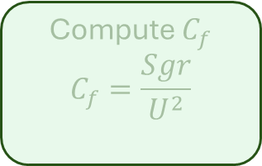
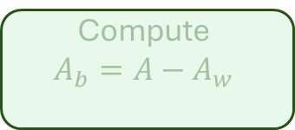
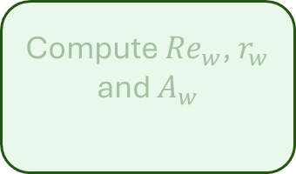
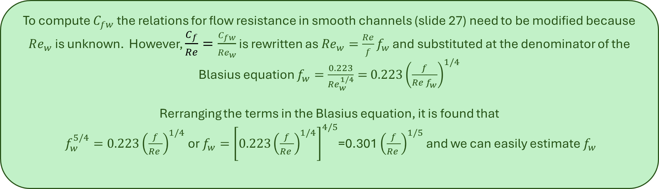

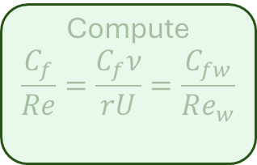
Sidewall correction calculation procedure
To compute $C_{fw}$ the relations for flow resistance in smooth channels (slide 27) need to be modified because $Re_{w}$ is unknown. However, $\frac{C_{f}}{Re}=\frac{C_{fw}}{{Re}_{w}}$ is rewritten as ${Re}_{w}=\frac{Re}{f}f_{w}$ and substituted at the denominator of the Blasius equation $f_{w}=\frac{0.223}{{Re}_{w}^{1/4}}=$ $0.223{\left(\frac{f}{Re f_{w}}\right)}^{1/4}$
Rerranging the terms in the Blasius equation, it is found that
$f_{w}^{5/4}=0.223{\left(\frac{f}{Re }\right)}^{1/4}$ or $f_{w}={\left[0.223{\left(\frac{f}{Re }\right)}^{1/4}\right]}^{4/5}$=0.301 ${\left(\frac{f}{Re }\right)}^{1/5}$ and we can easily estimate $f_{w}$
Known parameters
Unknowns
Flume width B
Water discharge Q
Water depth H
Bed slope S
Sediment properties R, D_{g}, D₅₀, D₉₀
Water properties ρ, ν
Acceleration of gravity g
Shear stress acting on the bed τ_{b}
Shear stress acting on the wall τ_{w}
Smooth wall
Rough bed
Compute $C_{f}$
$$C_{f}=\frac{Sgr}{U^{2}}$$
Compute
$$\frac{C_{f}}{Re}=\frac{C_{f}ν}{rU}=\frac{C_{fw}}{Re_{w}}$$
Compute $C_{fw}$ with a relation for smooth boundaries and $τ_{w}$
Compute ${Re}_{w}$, $r_{w}$ and $A_{w}$
Compute the sidewall corrected bed shear stress as
$τ_{b}=ρC_{fb}U^{2}$
Compute $C_{fb}$ from
Compute
$$A_{b}=A−A_{w}$$
$$\frac{f}{8}=C_{f}$$
$C_{f}P=C_{fb}P_{b}+$ $C_{fw}P_{w}$

Slide 30
Einstein decomposition
When bedforms are not present, the drag on the bed is associated only with stresses acting tangentially to the bed (skin friction) that are responsible for transporting sediment as bedload transport.
In presence of bedforms, part of the drag (form drag) is associated with complex interaction between bedforms and flow (primarily flow separation) and does not contribute directly to bedload transport.
It is thus necessary to partition the flow resistance (and the bed shear stress) between skin friction and form drag to estimate values of bed shear stress for bedload transport calculations.

Slide 31
Einstein decomposition
Let’s consider an ideal flow over a flat bed with the same microscopic roughness, energy gradient S_{f} and mean flow velocity U as the flow in the presence of bedforms.

Slide 32
Einstein decomposition
Let’s consider an ideal flow over a flat bed with the same microscopic roughness, energy gradient S_{f} and mean flow velocity U as the flow in the presence of bedforms.
Equilibrium flow with bedforms (skin friction + form drag)
Ideal flow over a flat bed
(skin friction)
U
H
U
H_{s}
S = S_{f}
S = S_{f}

Slide 33


Einstein decomposition
Let’s consider an ideal flow over a flat bed with the same microscopic roughness, energy gradient S_{f} and mean flow velocity U as the flow in the presence of bedforms.
Equilibrium flow with bedforms (skin friction + form drag)
Ideal flow over a flat bed
(skin friction)
U
H
U
H_{s}
S = S_{f}
S = S_{f}
$$τ_{b}=ρC_{fb}U^{2}=ρgHS$$
$$τ_{bs}=ρC_{fbs}U^{2}=ρgH_{s}S$$
with C_{fbs} < C_{f} and H_{s} < H
C_{fbs} = friction coefficient due to skin friction
H_{s} = water depth associated with skin friction

Slide 34


Einstein decomposition
Let’s consider an ideal flow over a flat bed with the same microscopic roughness, energy gradient S_{f} and mean flow velocity U as the flow in the presence of bedforms.
Equilibrium flow with bedforms (skin friction + form drag)
Ideal flow over a flat bed
(skin friction)
U
H
U
H_{s}
S = S_{f}
S = S_{f}
$$τ_{b}=ρC_{f}U^{2}=ρgHS$$
$$τ_{bs}=ρC_{fs}U^{2}=ρgH_{s}S$$
$τ_{bf}=τ_{b}−τ_{bs}$ mean bed shear stress due to bedform form drag
NOTE
if bedforms are present,
C_{fs} < C_{f} and H_{s} < H
$C_{fbf}=C_{fb}−C_{fbs}$ friction coefficient associated with form drag
$H_{f}=H−H_{s}$ mean flow depth associated with form drag

Slide 35






Einstein decomposition
Let’s consider an ideal flow over a flat bed with the same microscopic roughness, energy gradient S_{f} and mean flow velocity U as the flow in the presence of bedforms.
Equilibrium flow with bedforms (skin friction + form drag)
Ideal flow over a flat bed
(skin friction)
U
H
U
H_{s}
S = S_{f}
S = S_{f}
$$τ_{b}=ρC_{fb}U^{2}=ρgHS$$
$$τ_{bs}=ρC_{fbs}U^{2}=ρgH_{s}S$$
$τ_{b}=τ_{bs}+τ_{bf}$
$τ_{bf}=ρC_{fbf}U^{2}=ρgH_{f}S$
NOTE
if bedforms are present,
C_{fbs} < C_{f} and H_{s} < H
$ρC_{fb}U^{2}=ρC_{fbs}U^{2}+ρC_{fbf}U^{2}$
$C_{fb}=C_{fbs}+C_{fbf}$
$$ρgHS=ρgH_{s}S+ρgH_{f}S$$
$H=H_{s}+H_{f}$

Slide 36

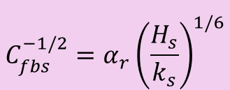
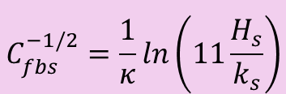
Einstein decomposition
An ideal flow over a flat bed with the same microscopic roughness, energy gradient S_{f} and mean flow velocity U as the flow in the presence of bedforms is considered.
Equilibrium flow with bedforms (skin friction + form drag)
Ideal flow over a flat bed
(skin friction)
U
H
U
H_{s}
S = S_{f}
S = S_{f}
$$τ_{b}=ρC_{fb}U^{2}=ρgHS$$
$$τ_{bs}=ρC_{fbs}U^{2}=ρgH_{s}S$$
Calculation of C_{fbs}
we use a Manning-Strickler formulation
NOTE
if bedforms are present,
C_{fbs} < C_{f} and H_{s} < H
$$C_{fbs}^{−1/2}=\frac{1}{κ}ln\left(11\frac{H_{s}}{k_{s}}\right)$$
$$C_{fbs}^{−1/2}=α_{r}{\left(\frac{H_{s}}{k_{s}}\right)}^{1/6}$$
$$k_{s}=n_{k}D_{s90}$$

Slide 37
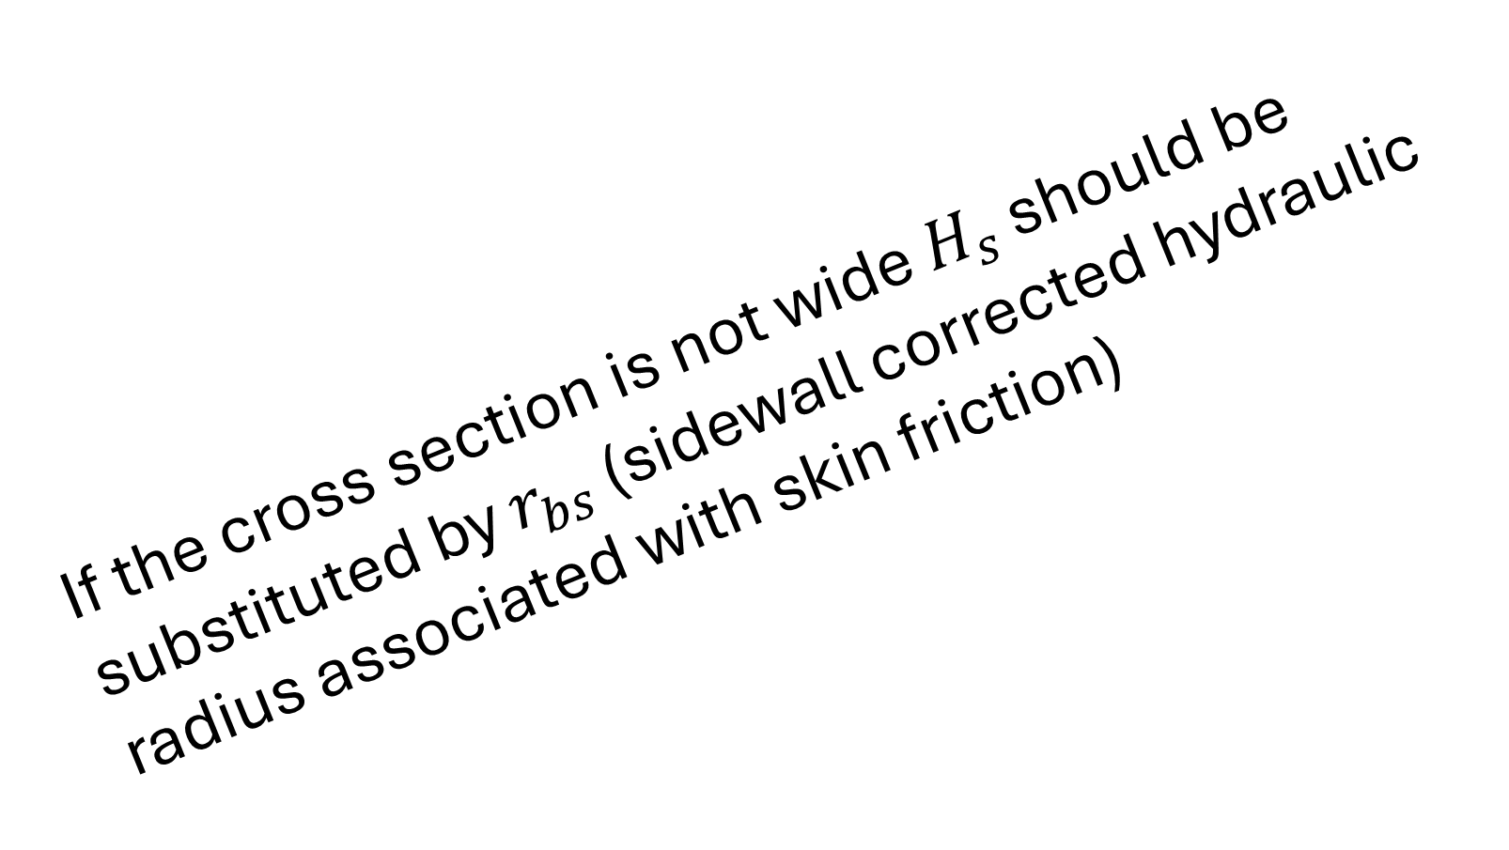
Einstein decomposition
An ideal flow over a flat bed with the same microscopic roughness, energy gradient S_{f} and mean flow velocity U as the flow in the presence of bedforms is considered.
Equilibrium flow with bedforms (skin friction + form drag)
Ideal flow over a flat bed
(skin friction)
If the cross section is not wide $H_{s}$ should be substituted by $r_{bs}$(sidewall corrected hydraulic radius associated with skin friction)
U
H
U
H_{s}
S = S_{f}
S = S_{f}
$$τ_{b}=ρC_{fb}U^{2}=ρgHS$$
$$τ_{bs}=ρC_{fbs}U^{2}=ρgH_{s}S$$
Calculation of C_{fbs}
we use a Manning-Strickler formulation
NOTE
if bedforms are present,
C_{fbs} < C_{f} and H_{s} < H
$$C_{fbs}^{−1/2}=\frac{1}{κ}ln\left(11\frac{H_{s}}{k_{s}}\right)$$
$$C_{fbs}^{−1/2}=α_{r}{\left(\frac{H_{s}}{k_{s}}\right)}^{1/6}$$
$$k_{s}=n_{k}D_{s90}$$

Slide 38


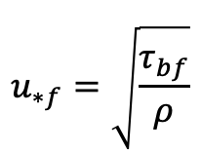


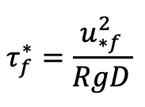
Einstein decomposition
An ideal flow over a flat bed with the same microscopic roughness, energy gradient S_{f} and mean flow velocity U as the flow in the presence of bedforms is considered.
Equilibrium flow with bedforms (skin friction + form drag)
Ideal flow over a flat bed
(skin friction)
U
H
U
H_{s}
S = S_{f}
S = S_{f}
$$τ_{b}=ρC_{fb}U^{2}=ρgHS$$
$$τ_{bs}=ρC_{fbs}U^{2}=ρgH_{s}S$$
The total shear velocity u*, the shear velocities associated with skin friction and form drag u_{*s} and u_{*f}, and the corresponding Shields numbers are
NOTE
if bedforms are present,
C_{fbs} < C_{f} and H_{s} < H
$$u_{∗}=\sqrt{\frac{τ_{b}}{ρ}}$$
$$u_{∗s}=\sqrt{\frac{τ_{bs}}{ρ}}$$
$$u_{∗f}=\sqrt{\frac{τ_{bf}}{ρ}}$$
$$τ_{s}^{∗}=\frac{u_{∗s}^{2}}{RgD}$$
$$τ_{f}^{∗}=\frac{u_{∗f}^{2}}{RgD}$$
$$τ^{∗}=\frac{u_{∗}^{2}}{RgD}$$

Slide 39
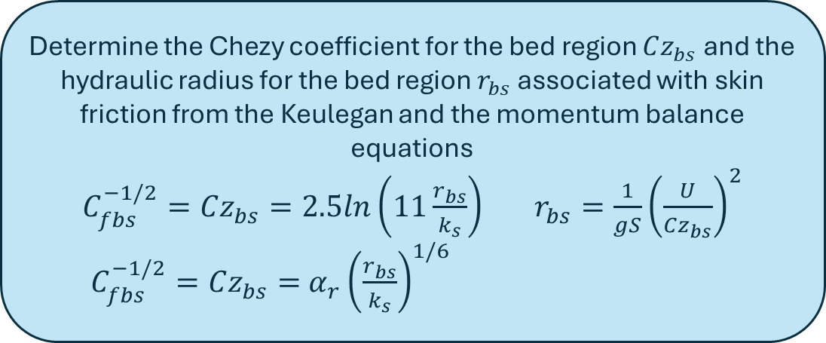
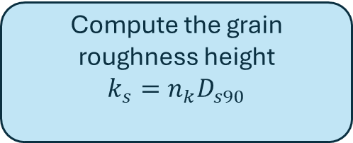
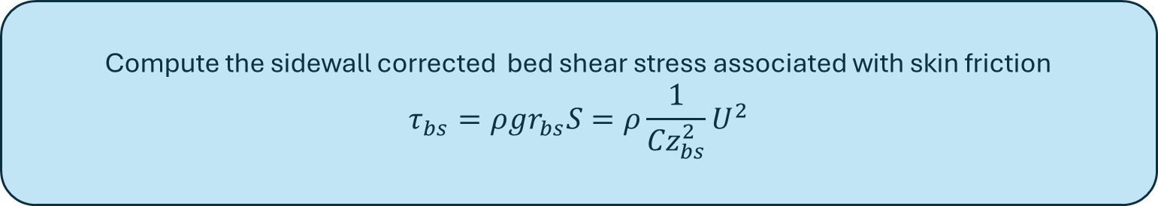
Einstein decomposition calculation procedure
Compute the grain roughness height
$$k_{s}=n_{k}D_{s90}$$
Determine the Chezy coefficient for the bed region $Cz_{bs}$ and the hydraulic radius for the bed region $r_{bs}$ associated with skin friction from the Keulegan and the momentum balance equations
$C_{fbs}^{−1/2}=Cz_{bs}=2.5ln\left(11\frac{r_{bs}}{k_{s}}\right)$ $r_{bs}=\frac{1}{gS}{\left(\frac{U}{Cz_{bs}}\right)}^{2}$
$C_{fbs}^{−1/2}=Cz_{bs}=$ $α_{r}{\left(\frac{r_{bs}}{k_{s}}\right)}^{1/6}$
Compute the sidewall corrected bed shear stress associated with skin friction
$$τ_{bs}=ρgr_{bs}S=ρ\frac{1}{{Cz}_{bs}^{2}}U^{2}$$

Slide 40






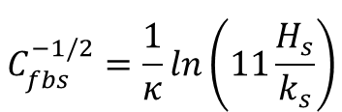

Engelund and Hansen predictor of dune form drag
Engelund and Hansen in 1967 determined the following relation to compute form drag in presence of dunes
$$τ_{s}^{∗}=0.06+0.4{\left(τ^{∗}\right)}^{2}$$
or
$$τ_{f}^{∗}=τ^{∗}−τ_{s}^{∗}=τ^{∗}−\left[0.06+0.4{\left(τ^{∗}\right)}^{2}\right]$$
This relation is designed to be used with the following resistance relation
$$C_{fbs}^{−1/2}=\frac{1}{κ}ln\left(11\frac{H_{s}}{k_{s}}\right)$$
no form drag
$$τ_{s}^{∗}$$
form drag
$$k_{s}=n_{k}D_{s65}$$
$$τ_{f}^{∗}$$
$$τ_{s}^{∗}$$
$$τ^{∗}$$

Slide 41
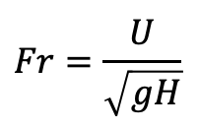


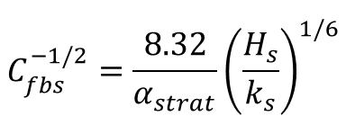
Wright and Parker predictor of dune form drag
Wright and Parker in 2004 noticed that the Engelund and Hansen predictor tends to work well in the laboratory, for small and medium streams, i.e. streams in which the dune-upper plane bed transition occurs for discharges smaller than bankfull.
The Engelund and Hansen predictor does not work well in large sand bed rivers, where dunes persist at and above bankfull conditions. Wright and Parker modified it to cover small and large streams
$$Fr=\frac{U}{\sqrt{gH}}$$
$$τ_{s}^{∗}=0.05+0.7{\left(τ^{∗}{Fr}^{0.7}\right)}^{0.8}$$
where Fr is the Froude number
The above predictor should be used with the following resistance relation
$$C_{fbs}^{−1/2}=\frac{8.32}{α_{strat}}{\left(\frac{H_{s}}{k_{s}}\right)}^{1/6}$$
α_{strat} is a correction for flow stratification which can be set equal to one in absence of additional information
$$k_{s}=3D_{s90}$$

